Slide 1

CZ3005 Artificial Intelligence Reinforcement Learning
Asst/P Hanwang Zhang
https://personal.ntu.edu.sg/hanwangzhang/
Email: hanwangzhang@ntu.edu.sg
Office: N4-02c-87

Slide 2
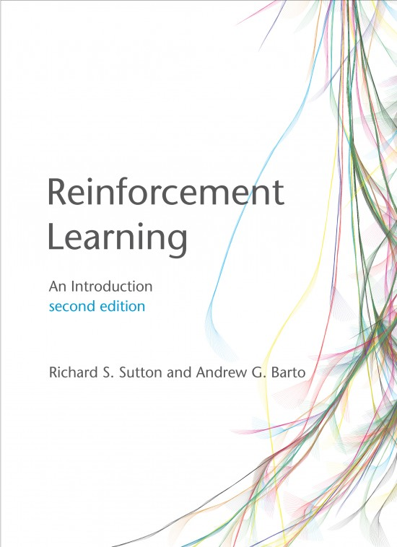
Lesson Outline
Some RL algorithms:
Monte-Carlo
Temporal difference
Q-learning
Deep Q-Network
Notes:
These 4 concepts will be enough for you to explore the world of RL.

Slide 3
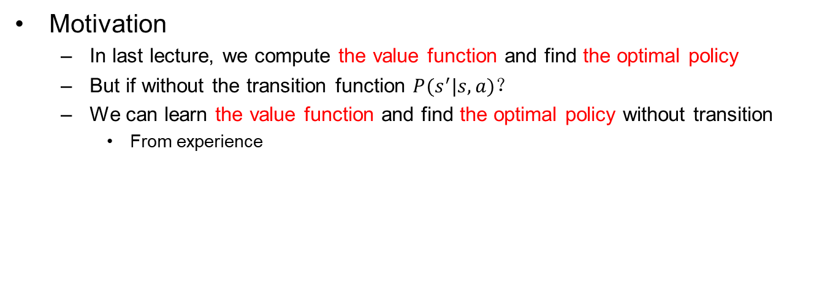
Reinforcement Learning
Motivation
In last lecture, we compute the value function and find the optimal policy
But if without the transition function $P(s^{′}|s,a)$？
We can learn the value function and find the optimal policy without transition
From experience
Experience
learning
Policy/Value
Notes:
With P(s’|s,a), we don’t need to try the world at all.
Without P(s’|s,a), we need to feel the world by ourselves.
From a statistical point of view, you are sampling from P(s’|s,a). I don’t read your mind, but I sample your behavior. And judge you,

Slide 4
RL algorithms
Model-free
Learning
Types
Monte Carlo
Q-Learning
DQN
…
Sampling
Monte Carlo
Bootstrapping
Q-Learning
DNN for Function Approx.
DQN
Notes:
Sometimes, we need to combine model and model-free. Think of some examples of model-based and model-free.

Slide 5
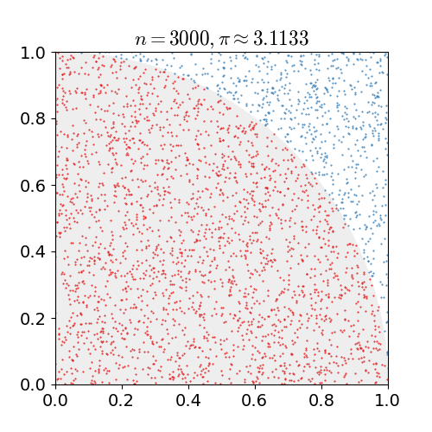
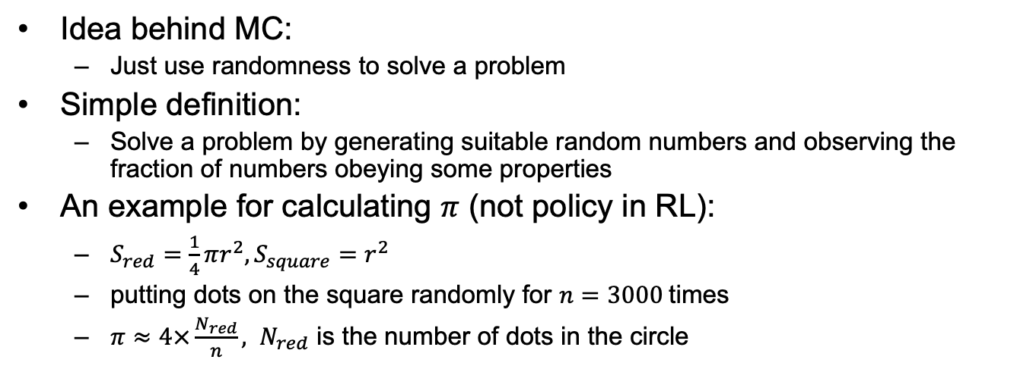
What is Monte Carlo
Idea behind MC:
Just use randomness to solve a problem
Simple definition:
Solve a problem by generating suitable random numbers and observing the fraction of numbers obeying some properties
An example for calculating $π$ (not policy in RL):
$S_{red}=\frac{1}{4}πr^{2}, S_{square}=r^{2}$
putting dots on the square randomly for $n=3000$times
$π≈4×\frac{N_{red}}{n}, N_{red}$ is the number of dots in the circle
Notes:
Simple definition is not human language: watch and learn.

Slide 6
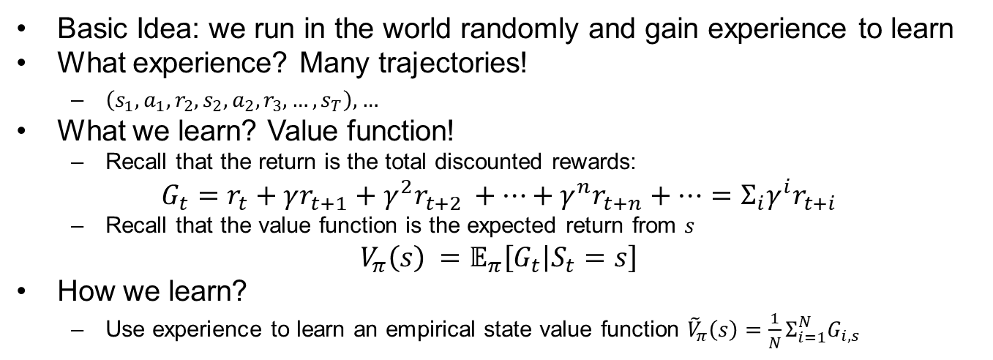
Monte Carlo in RL: Prediction
Basic Idea: we run in the world randomly and gain experience to learn
What experience? Many trajectories!
$\left(s_{1},a_{1},r_{2},s_{2},a_{2},r_{3},…,s_{T}\right),…$
What we learn? Value function!
Recall that the return is the total discounted rewards:
$$G_{t}=r_{t}+γr_{t+1}+γ^{2}r_{t+2 }+…+γ^{n}r_{t+n}+…=Σ_{i}γ^{i}r_{t+i}$$
Recall that the value function is the expected return from $s$
$$V_{π}\left(s\right) =𝔼_{π}\left[G_{t} | S_{t}=s\right]$$
How we learn?
Use experience to learn an empirical state value function ${\tilde{V}}_{π}\left(s\right)=\frac{1}{N}Σ_{i=1}^{N}G_{i,s}$
Notes:
In previous lecture, we use bellman equation. if we have P(s’|s,a), we can completely calculate Vpi. But now, we can only rely on experience.

Slide 7
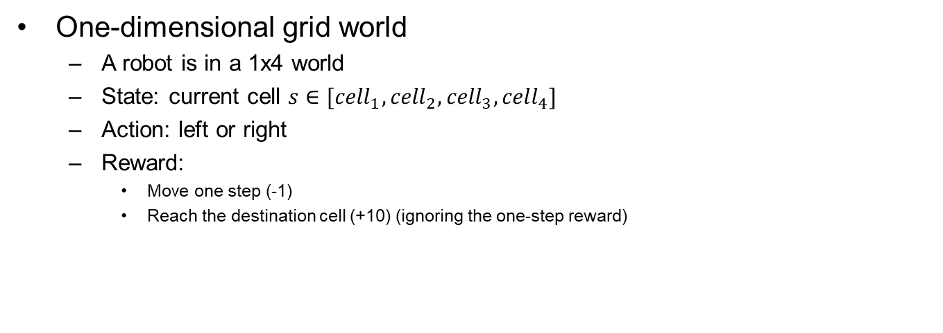




An Example
One-dimensional grid world
A robot is in a 1x4 world
State: current cell $s∈[{cell}_{1},{cell}_{2},{cell}_{3},{cell}_{4}]$
Action: left or right
Reward:
Move one step (-1)
Reach the destination cell (+10) (ignoring the one-step reward)
$${cell}_{1}$$
$${cell}_{2}$$
$${cell}_{3}$$
$${cell}_{4}$$
Start point
Destination
Notes:
The transition is your mind.

Slide 8



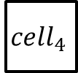



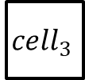

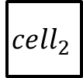


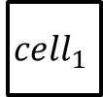


One-dimensional Grid World
$${cell}_{1}$$
$${cell}_{2}$$
$${cell}_{3}$$
$${cell}_{4}$$
Trajectory or episode:
The sequence of states from the staring state to the terminal state
Robot starts in ${cell}_{2}$, ends in ${cell}_{4}$
The representation of the three episodes
Start point
Destination
-1
10
-1
-1
-1
10
$${cell}_{2}$$
$${cell}_{3}$$
$${cell}_{4}$$
$${cell}_{2}$$
$${cell}_{3}$$
$${cell}_{2}$$
$${cell}_{3}$$
$${cell}_{4}$$
1
2
-1
-1
-1
10
$${cell}_{2}$$
$${cell}_{1}$$
$${cell}_{2}$$
$${cell}_{3}$$
$${cell}_{4}$$
3

Slide 9

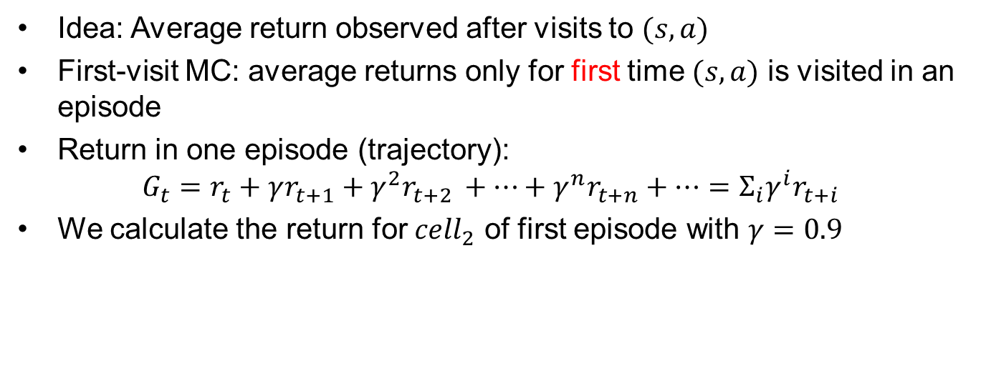



Compute Value Function
Idea: Average return observed after visits to $(s,a)$
First-visit MC: average returns only for first time $(s,a)$ is visited in an episode
Return in one episode (trajectory):
$$G_{t}=r_{t}+γr_{t+1}+γ^{2}r_{t+2 }+…+γ^{n}r_{t+n}+…=Σ_{i}γ^{i}r_{t+i}$$
We calculate the return for ${cell}_{2}$ of first episode with $γ=0.9$
-1
10
$${cell}_{2}$$
$${cell}_{3}$$
$${cell}_{4}$$
$G_{t}=−1×{0.9}^{0}+10×{0.9}^{1}=8$

Slide 10


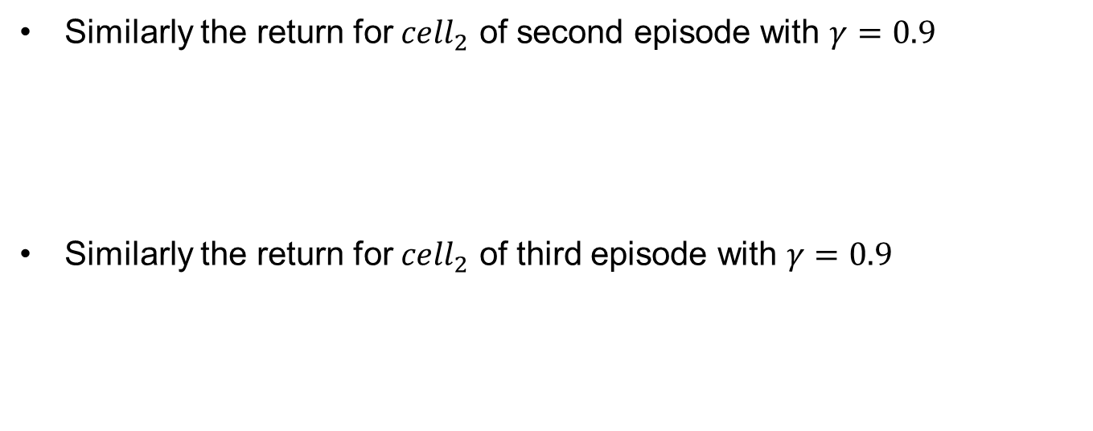







Compute Value Function (cont’d)
Similarly the return for ${cell}_{2}$ of second episode with $γ=0.9$
Similarly the return for ${cell}_{2}$ of third episode with $γ=0.9$
-1
-1
-1
10
$${cell}_{2}$$
$${cell}_{3}$$
$${cell}_{2}$$
$${cell}_{3}$$
$${cell}_{4}$$
$G_{t}=−1×{0.9}^{0}−1×{0.9}^{1}−1×{0.9}^{2}+10×{0.9}^{3}=4.58$
-1
-1
-1
10
$${cell}_{2}$$
$${cell}_{1}$$
$${cell}_{2}$$
$${cell}_{3}$$
$${cell}_{4}$$
$G_{t}=−1×{0.9}^{0}−1×{0.9}^{1}−1×{0.9}^{2}+10×{0.9}^{3}=4.58$
The empirical value function for ${cell}_{2}$ is $\frac{8 +4.58+4.58}{3}=5.72$
Notes:
HIGHLIGHT: different student may have different evaluations, as you have different priors for where to go☺, please try.
This is inherently because everyone of us may have a unique MODEL transition.

Slide 11
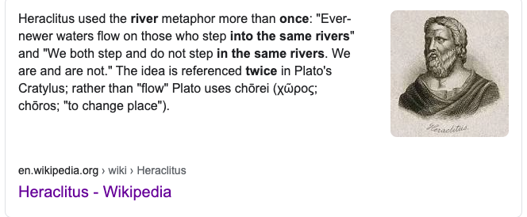
Why First Visit?

Slide 12



Compute Value Function (cont’d)
Given these three episodes, we compute the value function for all non-terminal state
We can get more accurate value function with more episodes
6.2
$${cell}_{1}$$
5.72
$${cell}_{2}$$
8.73
$${cell}_{3}$$
Notes:
1: -1+- 0.9 + 0.81x10 = 6.2
3: 10+6.2+10 = 8.73

Slide 13
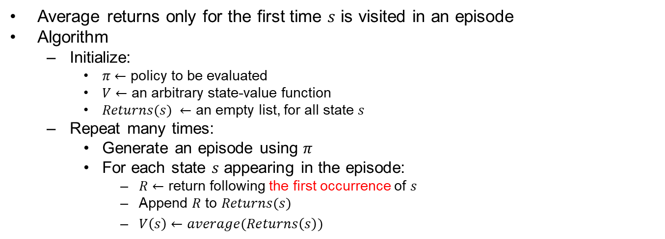
First Visit Monte Carlo Policy Evaluation
Average returns only for the first time $s$ is visited in an episode
Algorithm
Initialize:
$π←$ policy to be evaluated
$V←$ an arbitrary state-value function
$Returns(s) ←$ an empty list, for all state $s$
Repeat many times:
Generate an episode using $π$
For each state $s$ appearing in the episode:
$R←$ return following the first occurrence of $s$
Append $R$ to $Returns(s)$
$V\left(s\right)←average(Returns\left(s\right))$
Notes:
This cannot guarantee policy? Ask questions why? Answer: no model (transition), cannot get Q.

Slide 14
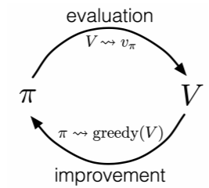
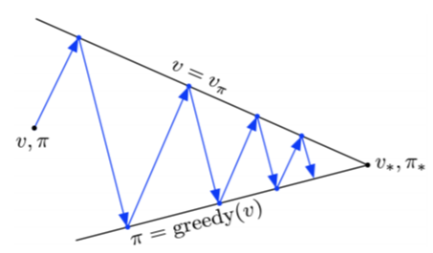
Monte Carlo in RL: Control
Now, we have the value function of all states given a policy
We need to improve policy to be better
Policy Iteration
Policy evaluation
Policy improvement
However, we need to know how good an action is
Notes:
In MDP, we can directly use Q(s,a): the connection between value and action. But, in model free, we don’t have this either, again, due to the lack of P(s’|s,a).

Slide 15

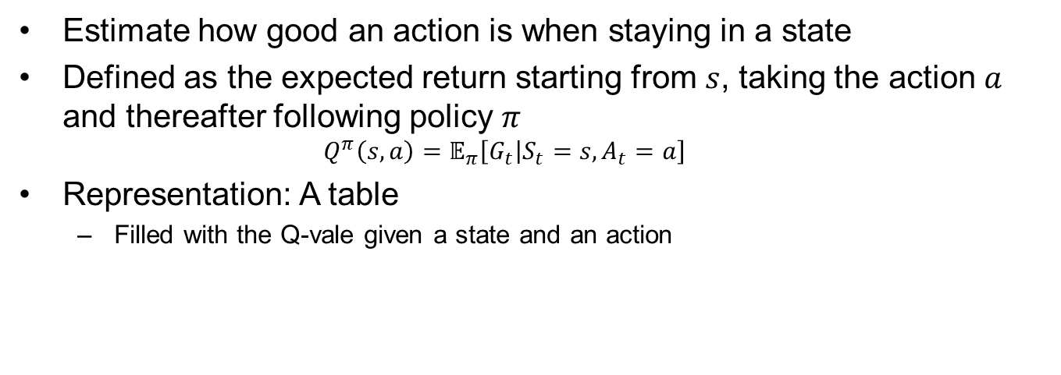


Q-value
Estimate how good an action is when staying in a state
Defined as the expected return starting from $s$, taking the action $a$ and thereafter following policy $π$
$$Q^{π}\left(s,a\right)=𝔼_{π}\left[G_{t} | S_{t}=s, A_{t}=a\right]$$
Representation: A table
Filled with the Q-vale given a state and an action
$${cell}_{1}$$
$${cell}_{2}$$
$${cell}_{3}$$

Slide 16



Computing Q-value
MC for estimating Q:
A slight difference from estimating the value function
Average returns for state-action pair $(s,a)$ is visited in an episode
We calculate the return for ${(cell}_{2}, right)$ of first episode with $γ=0.9$
-1
10
$${cell}_{2}$$
$${cell}_{3}$$
$${cell}_{4}$$
$G_{t}=−1×{0.9}^{0}+10×{0.9}^{1}=8$

Slide 17

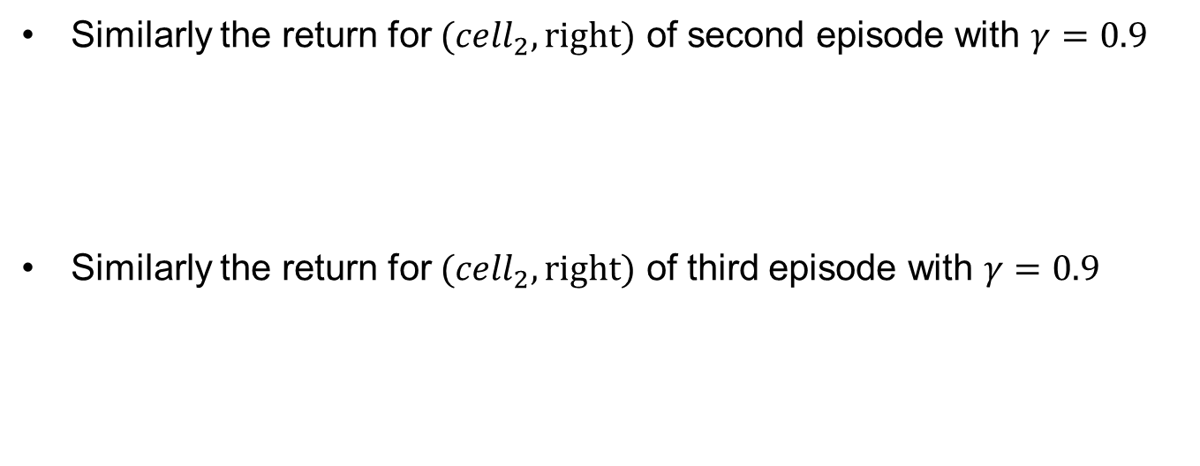









Compute Q-Value (cont’d)
Similarly the return for ${(cell}_{2}, right)$ of second episode with $γ=0.9$
Similarly the return for ${(cell}_{2}, right)$ of third episode with $γ=0.9$
-1
-1
-1
10
$${cell}_{2}$$
$${cell}_{3}$$
$${cell}_{2}$$
$${cell}_{3}$$
$${cell}_{4}$$
$G_{t}=−1×{0.9}^{0}−1×{0.9}^{1}−1×{0.9}^{2}+10×{0.9}^{3}=4.58$
-1
-1
-1
10
$${cell}_{2}$$
$${cell}_{1}$$
$${cell}_{2}$$
$${cell}_{3}$$
$${cell}_{4}$$
$G_{t}=−1×{0.9}^{0}+10×{0.9}^{1}=8$
The empirical Q-value function for ${(cell}_{2}, right)$ is $\frac{8 +4.58+8}{3}=6.86$
Notes:
-1,-0.9-0.81,7.29

Slide 18
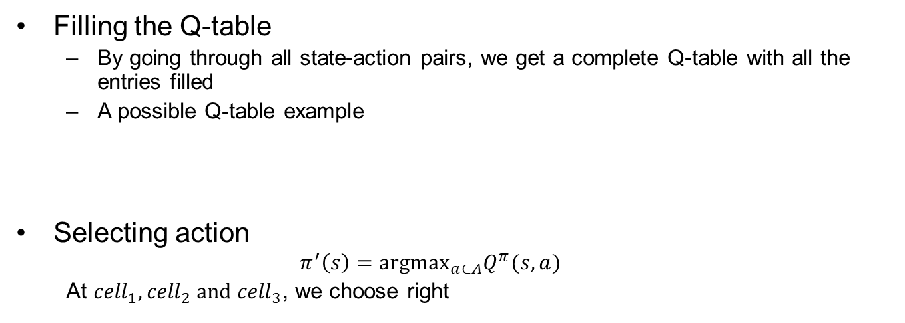



Q-Value for Control
Filling the Q-table
By going through all state-action pairs, we get a complete Q-table with all the entries filled
A possible Q-table example
Selecting action
$$π^{′}\left(s\right)={argmax}_{a∈A}Q^{π}(s,a)$$
At ${cell}_{1},{cell}_{2} and {cell}_{3}$, we choose right
$${cell}_{1}$$
$${cell}_{2}$$
$${cell}_{3}$$
6.2
6.9
10
0
4.6
6.2

Slide 19
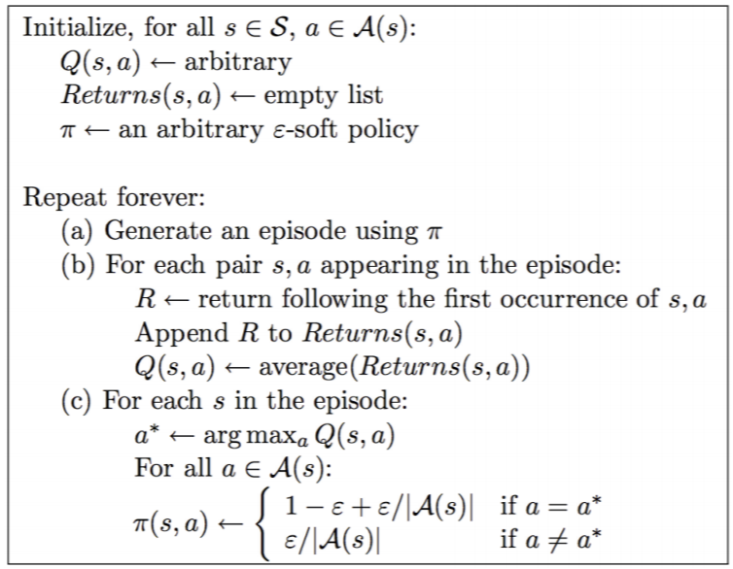
MC control algorithm
Policy evaluation
Policy improvement
Notes:
More background: given an imperfect agent, let it run, improve it by the run, and then let it run.
in MDP, we stop by a* = argmax.
This update: better Q, to better Pi, better Pi to better Q. Its called: reinforced. that is the name, and it is bootstrapping. so, reinforcement learning is all about boostrapping.

Slide 20
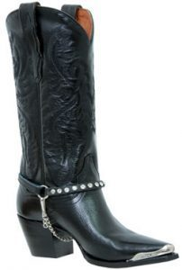
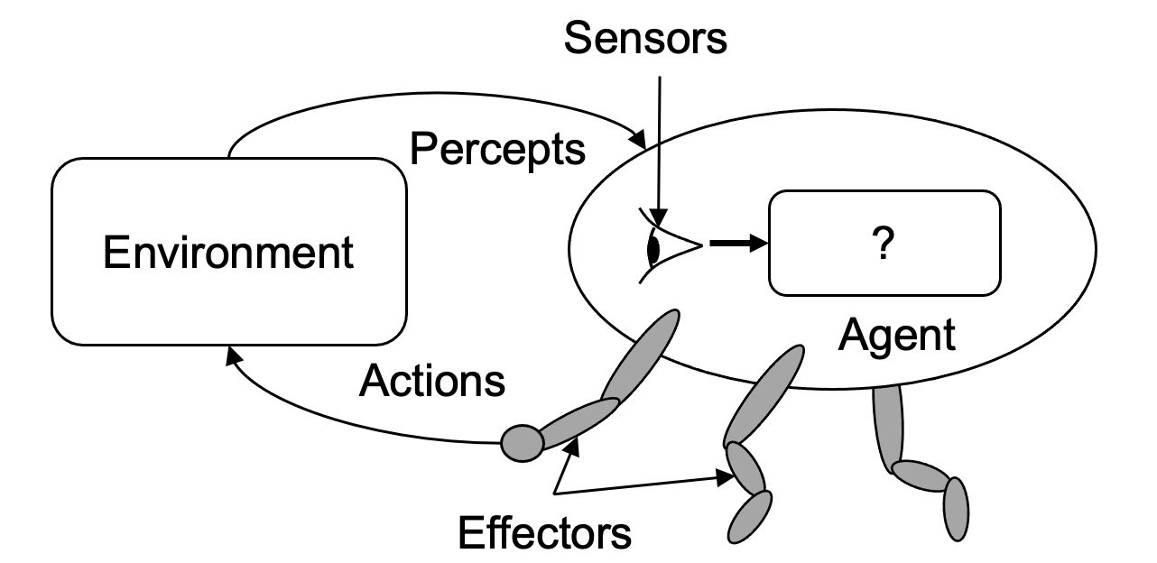
Q-Learning is Bootstrapping
Notes:
Reinforcement Learning is a very good example of bootstrapping. Its like re-read a book but with new understanding. That’s why we call reinforce. That is, we don’t need to sample a huge samples from environment to directly estimate the transition model. We only sample a small amount, update, and then re-sample.

Slide 21
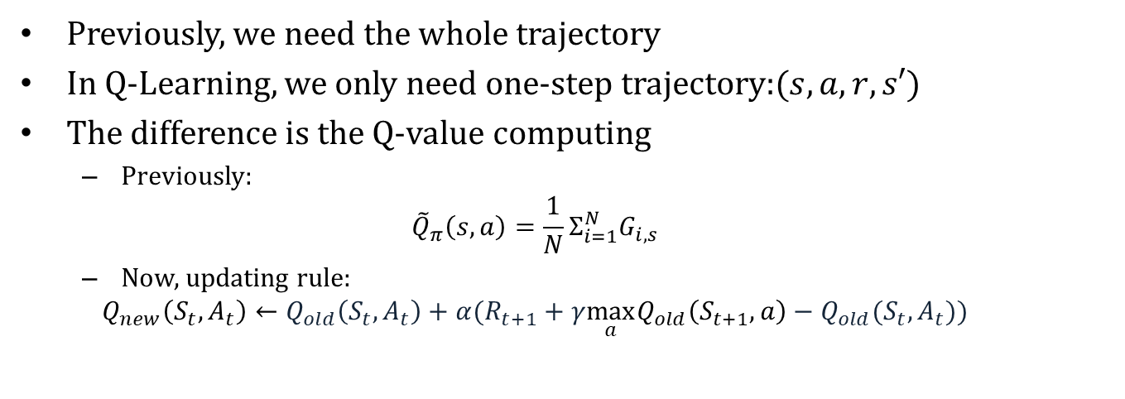
Q-Learning：the blessings of Temporal Difference
Previously, we need the whole trajectory
In Q-Learning, we only need one-step trajectory:$(s,a,r,s′)$
The difference is the Q-value computing
Previously:
$${\tilde{Q}}_{π}\left(s,a\right)=\frac{1}{N}Σ_{i=1}^{N}G_{i,s}$$
Now, updating rule:
$$Q_{new}\left(S_{t},A_{t}\right)←Q_{old}\left(S_{t},A_{t}\right)+α(R_{t+1}+γ\max_{a}Q_{old}\left(S_{t+1},a\right)−Q_{old}(S_{t},A_{t}))$$
old estimation
new estimation
learning rate
new sample

Slide 22
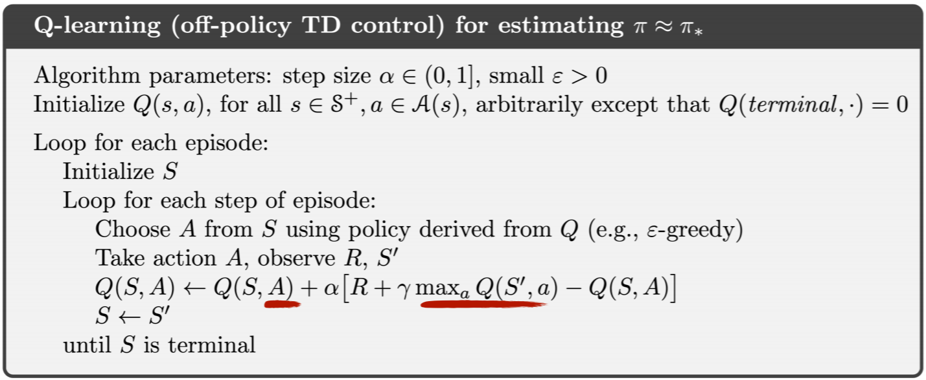
Q-Learning

Slide 23
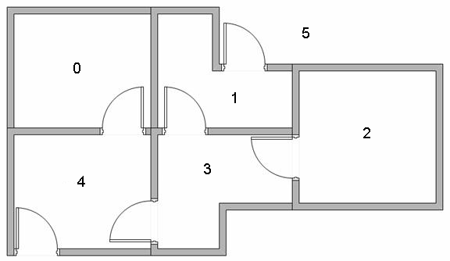
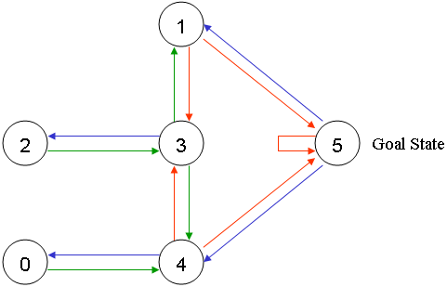
A Step-by-step Example
5-room environment as MDP
We'll number each room 0 through 4
The outside of the building can be thought of as one big room 5
End at room 5
Notice that doors at rooms 1 and 4 lead into the building from room 5 (outside)

Slide 24
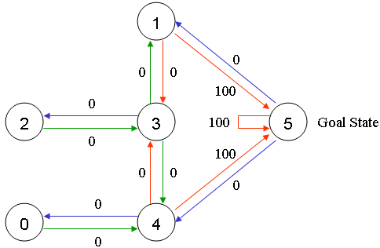


A Step-by-step Example (cont’d)
Goal
Put an agent in any room, and from that room, go outside (or room 5)
Reward
The doors that lead immediately to the goal have an instant reward of 100
Other doors not directly connected to the target room have zero reward
$$\begin{matrix}0 & 1 & 2 & 3 & 4 & 5\end{matrix}$$
action
$$R=\begin{matrix}0 \\ 1 \\ 2 \\ 3 \\ 4 \\ 5\end{matrix}\left[\begin{matrix}0 & 0 & 0 & 0 & 0 & 0 \\ 0 & 0 & 0 & 0 & 0 & 100 \\ 0 & 0 & 0 & 0 & 0 & 0 \\ 0 & 0 & 0 & 0 & 0 & 0 \\ 0 & 0 & 0 & 0 & 0 & 100 \\ 0 & 0 & 0 & 0 & 0 & 100\end{matrix}\right]$$
state
Notes:
Such zero reward is a good strategy for illegal actions. You no longer need a state-specific action inventory.

Slide 25
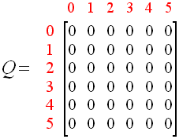
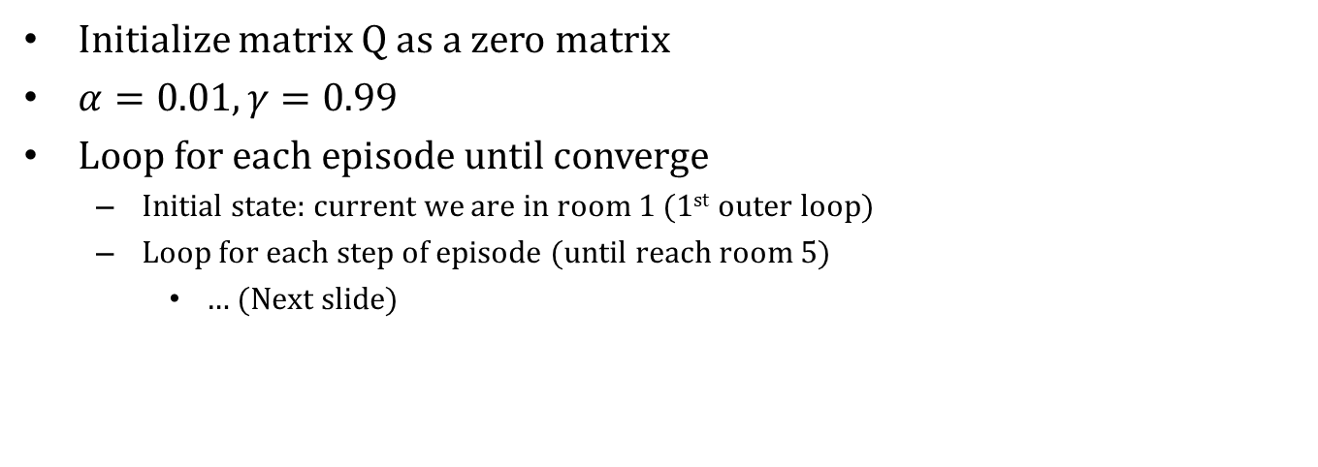
Q-Learning Step by Step
Initialize matrix Q as a zero matrix
$α=0.01,γ=0.99$
Loop for each episode until converge
Initial state: current we are in room 1 (1st outer loop)
Loop for each step of episode (until reach room 5)
… (Next slide)

Slide 26
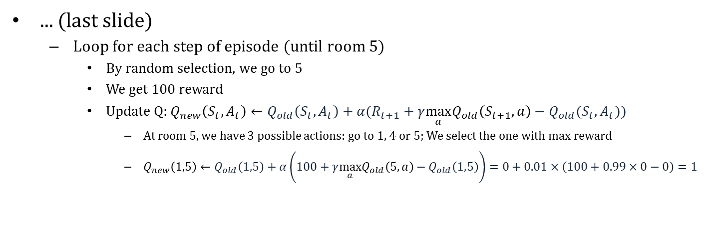
Q-Learning Step by Step (cont’d)
... (last slide)
Loop for each step of episode (until room 5)
By random selection, we go to 5
We get 100 reward
Update Q: $Q_{new}\left(S_{t},A_{t}\right)←Q_{old}\left(S_{t},A_{t}\right)+α(R_{t+1}+γ\max_{a}Q_{old}\left(S_{t+1},a\right)−Q_{old}(S_{t},A_{t}))$
At room 5, we have 3 possible actions: go to 1, 4 or 5; We select the one with max reward
$Q_{new}\left(1,5\right)←Q_{old}\left(1,5\right)+α\left(100+γ\max_{a}Q_{old}\left(5,a\right)−Q_{old}\left(1,5\right)\right)=0+0.01×\left(100+0.99×0−0\right)=1$
1

Slide 27
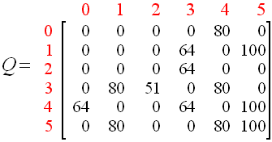
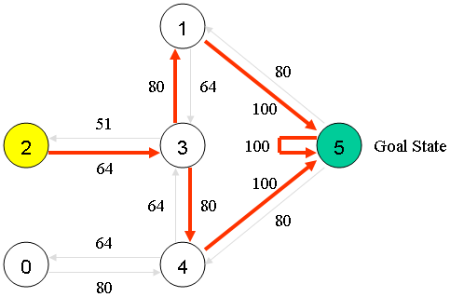
Q-Learning Step by Step (cont’d)
When we loop many episodes, we can get
According to this Q-table, we can select actions
E.g. We are at room 2
Greedily select based on maximun of Q value

Slide 28
An Example of Iteration Process
A complex grid world example
https://cs.stanford.edu/people/karpathy/reinforcejs/gridworld_td.html

Slide 29
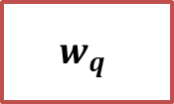



Deep Q-Network
Previously, we represent the Q-value as a table
However, tabular representation is insufficient
Many real world problems have enormous state and/or action spaces
Backgammon: 10^20 states
Computer Go: 10^170 states
Robots: continuous state space
We use a neural network as a black box to replace the table
Input a state and an action, output the Q-value
$$s$$
$$w_{q}$$
$$\hat{q}(s,a, w_{q})$$
$$a$$

Slide 30
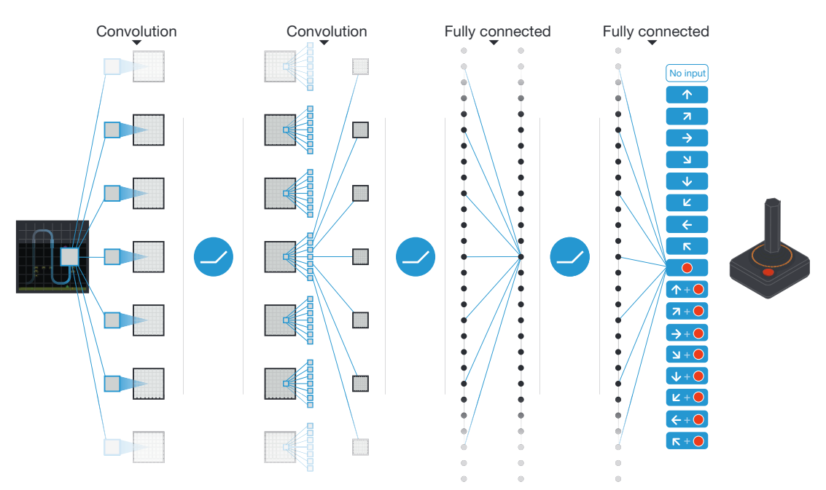

DQN in Atari
Input state s is stack of raw pixels from last 4 frames
Output is 𝑞(𝑠,𝑎) for 18 button
Reward is change in score for that step

Slide 31
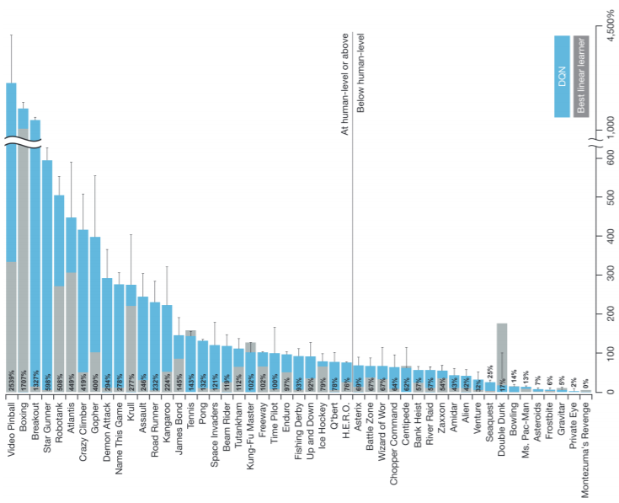
DQN in Atari (cont’d)
Pong’s video
https://www.youtube.com/watch?v=PSQt5KGv7Vk
Beat human on many games

